Slide 1
Junior Academy Application
Certification Overview

Slide 2
Junior Academy Application
Application for Certification
Certificate Types
Endorsements
Conditional Certificate
Designated Certificate
State Licensed Educators
Official Transcripts
Griggs/APLE Students
Senior Academy Partner Campus Students
Certification Contact Information

Slide 3





Application for Certification
Southern Union Certification Office
Application for Certification – New to Southern Union
Newly hired educators who never taught in the Southern Union
Newly hired educators from other unions
Former Southern Union Pre/K-12 school educators with certification
Retired, Public school teachers, Stay-at-home parents, etc.
All Teachers – Conference AND Locally Funded
Return the Application for Certification forms to the Certification office to receive your certificate
Located on the Teacher Certification webpage under “Quick Links” https://www.adventistedge.com/certification/

Slide 4
Certificate Types
Southern Union Certification Office
PK-12 Educators’ Certification Manual
Certification Certificates:
Basic Teaching Certificate
Standard Teaching Certificate
Professional Teaching Certificate
Administrator Certificate
Conditional Teaching Certificate
Designated Subjects/Services Certificate
The manual also provides detailed information on each certificate type as well as the general, renewal, and reinstatement requirements.

Slide 5
Endorsements
Southern Union Certification Office
Elementary Certification
Elementary endorsement covers all subject areas for grades 1 – 9
Teach 9th grade-subject areas in Junior Academies only
Secondary Certification
Covers specific subject areas for grades 6 – 12
Teach 6th through 12th grade-endorsed subject areas in Elementary, Junior Academy, and Senior Academy
9th through 12th grade Bible teachers must complete a Secondary Bible Methods course AND Secondary Bible Encounter Training
Junior Academy Endorsements
Can be added to Elementary or Secondary certification
Covers specific subject areas for grades 6 – 10
Teach 9th and 10th grade-endorsed subject areas in Junior Academies only
9th and 10th grade Bible teachers must complete a Bible Methods course AND Secondary Bible Encounter Training

Slide 6
Conditional Certification
Southern Union Certification Office
Valid for 1-year
General Requirements
  Must hold at least a Bachelor’s Degree
  Must work towards a Basic, Standard, or Professional Teaching Certificate or a specific endorsement
Renewal Requirements
Complete at least 6-academic semester credit hours each contract year
Courses must be completed from the educator’s Needs List
Complete at least one religion course yearly until religion requirements are met

Slide 7
Designated Certification
Southern Union Certification Office
Valid for 1 - 3 years from the certificate issued date
Non-core Subject Area
  See SUCOE Designated Cert - Non-Core Subject Area Endorsement Guidelines
General Requirements
Recommended by Conference Office of Education Superintendent
Meets initial General Eligibility Requirements
Provide verification of a high school diploma or highest degree
Provides verification of recent qualifying work experience in a non-core subject area
  At least one year of work experience must be in the most recent 3-years

Slide 8
Designated Certification
Southern Union Certification Office
Renewal Requirements
Complete a new Designated Services/Subjects Application
  Submit the completed DS form signed by the educator and Principal to the Superintendent’s Office for review and signature with:
    Current resume
    Documentation of completed renewal requirements
    If not previously submitted, verification of the highest level of education
Renewal requirements are established through collaboration between the educator, Principal, and Superintendent
  Specific renewal requirements consist of CEUs and/or academic credits that improve pedagogy and/or subject area expertise.
The Superintendent’s office will send the completed to the Union Registrar’s Office for processing

Slide 9
State License/Alternative Teaching Certification
Southern Union Certification Office
Designed for those who did not complete their teacher education in an Adventist college/university but hold a state teaching certificate/license but not an SDA teaching certificate.
State teaching certificate/license:
  Must be current at the time of application for certification
  Teaching certificate/license endorsements must be in the level/subject area for the educator will teach
The educator will be issued a Conditional certificate until all requirements for the Alternative Teaching certification have been met.

Slide 10
State License/Alternative Teaching Certification
Southern Union Certification Office
Must complete the following to be issued regular certification:
  Philosophy of Seventh-day Adventist education
  SDA religion courses
    Bible Doctrines
    Spirit of Prophecy
    SDA Church History
  Health principles based on the Bible and the writings of Ellen White
  Elementary Bible Encounter (for Elementary endorsement only)
Complete the course requirements through the following options:
  NAD Adventist college/university
  ALC-Adventist Learning Community (except Elementary religion methods)
  Challenge exams (Andrews University)
Renewal Requirements
  Follow the renewal requirements for Standard or Professional certificates

Slide 11
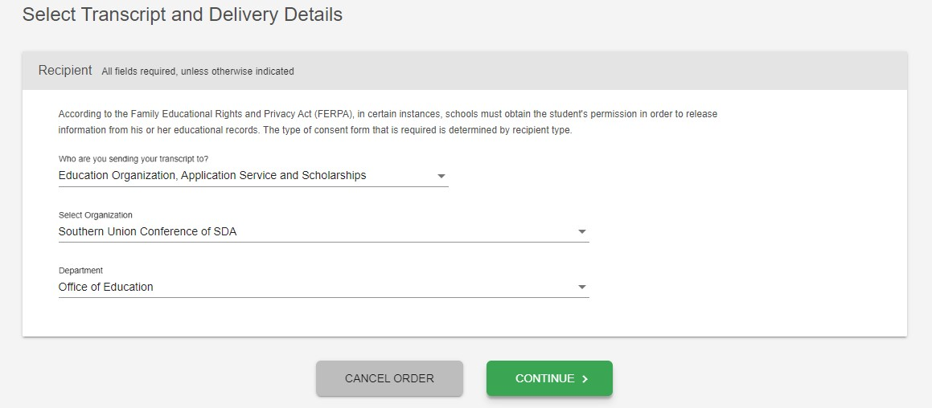
Official Transcripts
Southern Union Certification Office
National Student Clearinghouse
Who are you sending your transcript to: Education Organization, Application Service Scholarship
Select Organization: Southern Union Conference of SDA
Department: Office of Education

Slide 12
Official Transcripts
Southern Union Certification Office
Other Official Transcript Clearinghouses
Other Electronic Transcripts e-mail address: certification@southernunion.com
Official Transcript mailing address: Certification Registrar, Southern Union Conference of SDA, P.O. Box 923868, Peachtree Corners, GA 30010-3868
Please allow a minimum of 3-4 weeks for processing by the Certification Office
REMEMBER: As you complete academic classes, request Official Transcripts be sent directly to the Certification office electronically or by mail
Check your status in the NAD Dashboard

Slide 13
Official Transcripts
Southern Union Certification Office
Foreign Transcript Evaluations/Foreign Colleges/Universities
Submit a foreign transcript course-by-course evaluation.
  The National Association of Credential Evaluation Services website has a list of approved evaluation companies: http://www.naces.org/members.html
  Send your transcripts to be evaluated by any credible organization you choose.
  Request the company send a copy of the course-by-course evaluation to the Certification Office by email or mail.
    Email: certification@southernunion.com
    Mailing Address: P.O. Box 923868, Peachtree Corners, GA 30010
    Physical Address: 302 Research Drive, Peachtree Corners, GA 30092
    Fax: (770) 408-1801

Slide 14
Griggs/APLE Students
Southern Union Certification Office
Griggs/APLE Students
  Griggs/APLE students are not counted in the conference/Southern Union totals
  9th and/or 10th-grade students who receive 51% or more of their grades from Griggs/APLE are counted as APLE students
  Junior Academies partnering with APLE for 11th-grade and/or 12th-grade students housed at junior academies are counted as Griggs/APLE students

Slide 15
Senior Academy Partner Campus Students
Southern Union Certification Office
School Opening Report Section B – *Partner Campus
Junior Academies or Elementary schools partnered with an approved senior academy program for 9th, 10th, 11^{th,} and 12th-grade students on their campuses need to complete section “B” *Partner Campus in their school’s Opening Report to correctly identify and count these students.
9th and/or 10th-grade students who receive 51% or more of their grades from the Senior Academy Partner Camus are counted as Senior Academy students
All 11th and 12th-grade students belong to the Senior Academy regardless of the number of courses completed at the Senior Academy.
Review the Opening Report Assistant under “Reports/Data Rollup” in the School User Guide https://support.datarollup.info/category/school-user-guide/data-rollup-updates/2194

Slide 16
Certification Office
Southern Union Certification Office
Luberta Biggs, Registrar
Southern Union Conference Office of Education
(770) 408-1800, ext. 160
Lbiggs@southernunion.com
Betty Calderon, Administrative Assistant
Southern Union Conference Office of Education
(770) 408-1800, ext. 159
Bcalderon@southernunion.com
Certification Webpage: https://www.adventistedge.com/certification/

